Slide 1
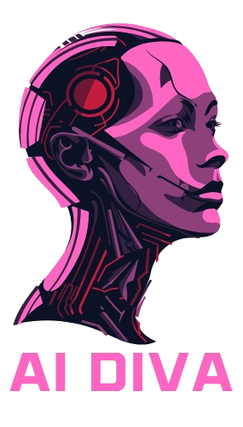
A.I. Diva: Engaging Students with Sassy AI
By: Rebecca Rahman, Gabriel Sosa, My Tran

Slide 2
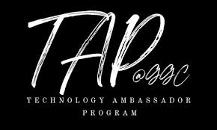
What is TAP?
A platform for students to create impactful tech projects
Promotes outreach, engagement, and active learning
Makes tech education accessible and fun for all ages

Slide 3
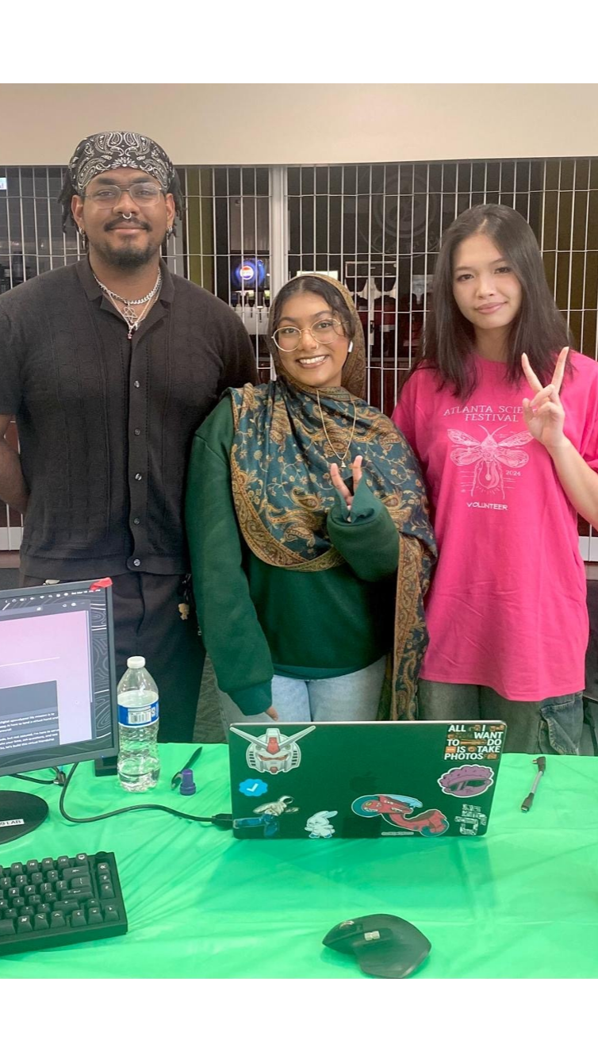
Why AI Diva?
The goal of this project is to teach students the proper use of AI and improve their interactions with this new technology.
This is Geared towards students, educators, and parents.
We hope that this helps engage younger students with Ai and enables them to think more critically when using it.

Slide 4

Goals of AI Diva
- Teach students how to use AI responsibly
01
- Improve interactions with modern AI tools
02
- Spark early interest in technology among youth
03

Slide 5

What We Built
- A sassy chatbot that encourages clear AI prompts
- A mini guessing game powered by OpenAI
- Front-end: HTML, JS, CSS | Back-end: Python
- API: OpenAI's GPT for conversation logic

Slide 6

Workshop Experience
- Students loved the sassy tone—it made learning fun
- Real-time feedback helped improve prompt clarity
- Personality made AI feel less intimidating and more approachable

Slide 7
Student Engagement Preferences

Slide 8
Improvement in AI Literacy (Pre vs. Post)

Slide 9
Ethical Awareness in AI Usage

Slide 10

Summary & What’s Next
- AI Diva is effective at boosting AI literacy
- Students became more aware of ethical concerns
- Future: Add multimedia features and adaptive learning paths
- Continue promoting outreach and engagement

Slide 11

References
[1] Dekhane, S., Xu, X., Napier, N., Barakat, R., Gunay, C., & Nagel, K. (2018). Technology-focused service-learning course to increase confidence and persistence in computing. Journal of Computing Sciences in Colleges, 34(2), 147-153. [2] Mosquera Reina, V., Cunico, R., Williams, J., Bauer, M., Doloc-Mihu, A., & Robertson, C. (2021). Introducing Programming Concepts through Interactive Online Workshops. Proceedings of the 22nd Annual Conference on Information Technology Education, 71-72. [3] Robertson, C., & Doloc-Mihu, A. (2021). Assessing the effectiveness of teaching programming concepts through online interactive outreach workshops. Proceedings of the 22nd Annual Conference on Information Technology Education, 123-128. [4] OpenAI. (2023). GPT-4 Technical Report.

